Slide 1
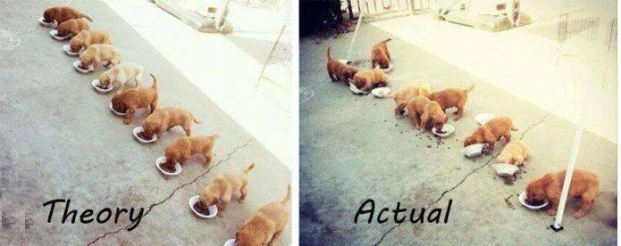
Multithreading Part I
SoftUni Team
Technical Trainers
Software University
http://softuni.bg

Slide 2
Table of Contents
Synchronous Programming
Asynchronous Programming
Multithreading
Threads
Race Condition
Dead Lock
Thread Pool

Slide 3
Table of Contents (2)
Exception Handling
Thread Synchronization
Monitor
Mutex
Semaphore
Lock

Slide 4
Have a Question?
sli.do
#csharp-masterclass

Slide 5

Synchronous Programming
Benefits and Drawbacks

Slide 6
Synchronous Programming
Executing program components sequentially
i.e. "Sequential programming"
Actions happen one after another
Uses a single thread of a single process
Components wait for previous components to finish
Program resources are accessible at all points

Slide 7
Synchronous Code
static void Main()
{
int n = int.Parse(Console.ReadLine());
PrintNumbersInRange(0, 10);
Console.WriteLine("Done.");
}
static void PrintNumbersInRange(int a, int b)
{
for (int i = a; i <= b; i++)
{
Console.WriteLine(i);
}
}
int n = int.Parse(..)
PrintNumbersInRange()
Console.WriteLine(..)
...
Synchronous code is executed step by step

Slide 8
Synchronous Code - Long Running Operation
Console.Write("Enter your name: ");
string name = Console.ReadLine();
for (int i = 0; i < int.MaxValue; i++)
{
// Execute some operations here
}
Console.WriteLine($"Hello, {name}!");
You will have to wait for the long-running operation to finish before you can see the greeting

Slide 9
Synchronous Programming Drawbacks
If one component is blocked, the entire program is blocked
UI may become unresponsive
No utilization of multi-core systems
CPU-demanding tasks delay execution of all other tasks
Accessing resources blocks entire program
Especially problematic with web resources

Slide 10

Asynchronous Programming
Benefits and Drawbacks

Slide 11
Asynchronous Programming
Program components can execute in parallel
Some actions run alongside other actions
Each action can happen in a separate thread
Independent components don't wait for each other
Program resources shared between threads
If one thread uses a resources, others shouldn't use it

Slide 12
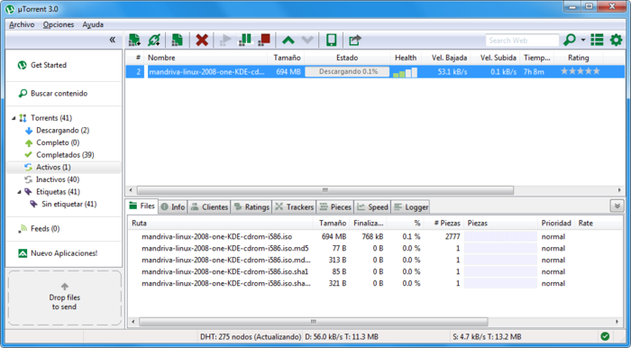
Asynchronous Programming – Benefits
If a component is blocked, other components still run
UI runs separately and always remains responsive
Utilization of multi-core systems
Each core executes one or more threads
CPU-demanding tasks run on "background" threads
Resource access runs on "background" threads

Slide 13
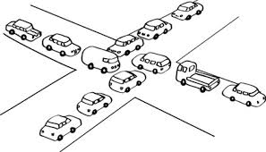
Asynchronous Programming – Drawbacks
Hard to know which code parts are running at a specific time
Harder than usual to debug
Have to protect resources
One thread uses a resource
Other threads must wait for the resource
Hard to synchronize resource access
Deadlocks can occur
Maybe slower, than synchronous on a single core server

Slide 14
Asynchronous Code
Asynchronous programming allows the execution of code simultaneously
int n = int.Parse(Console.ReadLine());
PrintNumbersInRange(0, 100);
var task = Task.Run(() =>
PrintNumbersInRange(100, 200));
Console.WriteLine("Done.");
task.Wait();
int n = int.Parse(..)
for (0..100)
Console.WriteLine(…)
for (100..200)
Wait()

Slide 15
Asynchronous vs Multithreading
A program may be asynchronous, but run on a single thread
Javascript is a single threaded, but it's not synchronous
A multithreaded program always runs on more than one thread

Slide 16

Threads

Slide 17
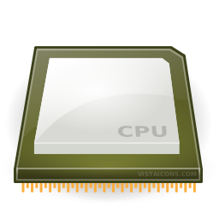
Instruction Execution
Each program's code is translated to CPU instructions
Program.cs
int a = 5;
int b = 4;
Console.WriteLine(a + b);
Compilation
Program.exe
Single-Core CPU
00DA2655 mov dword ptr [ebp-40h],5
00DA265C mov dword ptr [ebp-44h],4
00DA2663 mov ecx,dword ptr [ebp-40h]
00DA2666 add ecx,dword ptr [ebp-44h]
00DA2669 call 73B5A920
00DA266E nop
Instructions are executed one by one

Slide 18
Multi-Tasking
A computer can run many processes (applications) at once
But each CPU core can only execute one instruction at a time
Parellelism is achieved by the operating system's scheduler
Grants each thread a small interval of time to run
program.exe
chrome.exe
winamp.exe
system.exe
program.exe
...
0 5 10 15 20 25 ms

Slide 19
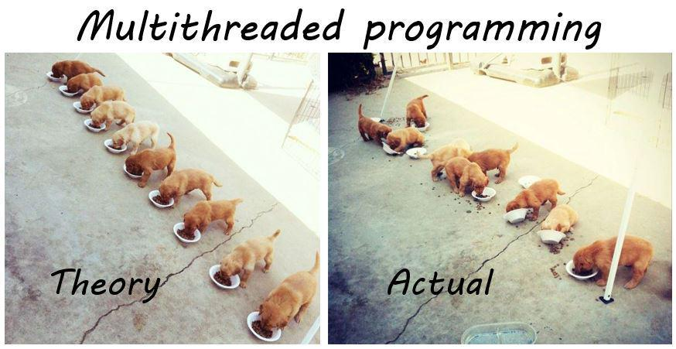
Threads
A thread is a fundamental unit of code execution
Commonly, processes (programs) use more than one thread
In .NET, there is always more than one thread (e.g. GC)
Each thread has a memory area associated with it known as a Call Stack
Stores local variables
Stores the currently invoked methods in order of invocation

Slide 20
Threads in C#
Threads in C# can be created using the System.Thread class
Constructor accepts a method (delegate) to execute on a separate thread
Thread thread = new Thread(() =>
{
for (int i = 0; i < 10; i++)
{
Console.WriteLine(i);
}
});

Slide 21
System.Thread
Start() – schedules the thread for execution
Join() – waits for the thread to finish its work (blocks the calling thread)
Thread primes = new Thread(() => PrintPrimesInRange(1, 10000));
primes.Start();
Console.WriteLine("Waiting for thread to finish work...");
primes.Join();

Slide 22
Problem: Even Numbers Thread
Print all even numbers in a given range
Printing should be executed on a separate thread
After all numbers are printed print "Thread finished work"
2
4
6
8
10
Thread finished work
1 10

Slide 23
Solution: Even Numbers Thread
// TODO: read start and end numbers
Thread evens = new Thread(() =>
PrintEvenNumbers(start, end));
evens.Start();
evens.Join();
Console.WriteLine("Thread finished work");
// TODO: implement method PrintEvenNumbers

Slide 24
Thread – Example
List<long> numbers = new List<long>();
Thread t = new Thread(() =>
SumOddNumbers(numbers, 10, 100000000L));
t.Start();
Console.WriteLine("What should I do?");
while (true)
{
string command = Console.ReadLine();
if (command == "exit") break;
}
t.Join();
Console interface
remains unblocked

Slide 25
Thread Stack
Each thread has its own stack
The start (bottom) of the stack is the method from which the thread began execution
Each method (frame) stores local variables
...
IsPrime()
PrintAllPrimes()
Main()
...
IsValidUrl
DownloadAsync
Background Thread
Main Thread

Slide 26

Race Conditions

Slide 27

Thread Race Conditions
A race condition occurs when two or more threads access shared data and they try to change it at the same time
List<int> numbers = Enumerable.Range(0, 10000).ToList();
for (int i = 0; i < 4; i++)
{
new Thread(() =>
{
while (numbers.Count > 0)
numbers.RemoveAt(numbers.Count - 1);
}).Start();
}

Slide 28

Thread Safety
A thread-safe resource can be safely accessed by multiple threads
lock keyword grants access to only one thread at a time
Avoids race conditions
Blocks any other threads until the lock is released
lock (numbers)
{
if (numbers.Count == 0) break;
int lastIndex = numbers.Count - 1;
numbers.RemoveAt(lastIndex);
}

Slide 29
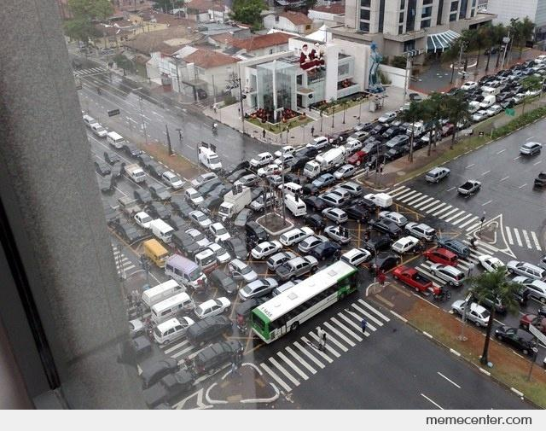
Deadlocks

Slide 30
Deadlocks
Having too much locking in an application can also get your application into trouble
In a deadlock, at least two threads wait for each other to release a lock
As both threads wait for each other, a deadlock situation occurs and the threads wait endlessly and your computer eventually hangs

Slide 31
Dead Lock - Example
static object obj1 = new object();
static object obj2 = new object();
public static void Main(string[] args)
{
Thread t1 = new Thread(new ThreadStart(DeadLock1));
Thread t2 = new Thread(new ThreadStart(DeadLock2));
t1.Start();
t2.Start();
}

Slide 32
Dead Lock – Example (2)
public static void DeadLock1()
{
lock (obj1)
{
Console.WriteLine("Thread 1 got locked");
Thread.Sleep(500);
lock (obj2)
{
Console.WriteLine("Thread 2 got locked");
}
}
}

Slide 33
Dead Lock – Example (3)
public static void DeadLock2()
{
lock (obj2)
{
Console.WriteLine("Thread 2 got locked");
Thread.Sleep(500);
lock (obj1)
{
Console.WriteLine("Thread 1 got locked");
}
}
}

Slide 34
Thread Pool

Slide 35
Thread Pooling
It is an approach for reducing load when creating and destroying threads
It creates a group of threads at the beginning of a multi-threaded application
They are called worker threads
Each thread "lives" in the so-called - Thread Pool
In a new task, a worker thread is used, then returned to the pool
It takes care of the life and distribution of tasks on the threads
The user of the threads is released from this load

Slide 36
System.Threading.ThreadPool
If a task is in the ThreadPool, it cannot be removed from it
Thread Pooling allows the OS to optimize the use of threads as their number is constant
Cases where ThreadPool is NOT recommended
If a control thread is needed
For time-consuming tasks, other tasks can be blocked
If it needs synchronization

Slide 37
volatile keyword
It indicates that a field might be modified by multiple threads that are executing at the same time
It ensures that all threads will observe volatile writes performed by any other thread in the order in which they were performed
It can be applied to fields of these types:
Reference types, simply types, enum, pointers
double and long cannot be marked volatile because reads and writes must be atomic.
Use the Interlocked class members or protect access using the lock statement.

Slide 38
Interlocked
Security of atomic operations - increase by 1, decrease by 1, exchange, comparison and more.
No need to synchronize the shared data
When requested by users, synchronization can be avoided with these methods
Methods do not throw execution

Slide 39
Interlocked
Increment/Decrement
Atomic operation unlike i++/i--
Exchange
Writes the value of the second parameter to the first, returns the original
CompareExchange
There are three parameters
Checks that the first and third are equal, if yes, records the second in the first
Used when dealing with temporary variables

Slide 40
Exception Handling

Slide 41
Exception Handling
Exceptions cannot be handled outside a thread
try
{
new Thread(DoWork).Start();
}
catch (Exception ex)
{
Console.WriteLine("Exception!");
}
This part will never be reached
public static void DoWork()
{
throw new ArgumentNullException();
}

Slide 42
Exception Handling – the Right Way
new Thread(DoWork).Start();
public static void DoWork()
{
try
{
throw new ArgumentNullException();
}
catch (Exception ex)
{
Console.WriteLine("Exception handled!");
}
}
Exceptions should be handled inside the executed method(s)

Slide 43

Synchronization
Monitors, Mutex, Semaphore, Locks

Slide 44
Monitor
The lock statement is resolved by the compiler to the use of the Monitor class
It is nearly similar to locks but has a big advantage compared to the lock statements in terms of control
You are able to instruct the active thread to wait for some duration time and inform waiting threads when the current thread is completed
Once processed by C# compiler, a lock scope resolves to the following code

Slide 45
Monitor - Example
object tLock = new object();
public void Calculation() {
Monitor.Enter(tLock);
try {
for (int i = 0; i < 10; i++) {
Thread.Sleep(new Random().Next(5));
Console.Write(" {0},", i);
}
}
catch{}
finally {
Monitor.Exit(tLock);
}
Console.WriteLine();
}

Slide 46
Mutex
Inherit to WaitHandle
OS sync primitive
Encapsulates Win32 synchronization handles
Mutex.WaitOne();
Mutex.ReleaseMutex();
Must be called the same number of times
Mutex.WaitOne();
WaitHandle.WaitAll()
Waits for two or more handles

Slide 47
Mutex - Example
private static Mutex mutex = new Mutex();
public static void Main(string[] args)
{
for (int i = 0; i < 4; i++)
{
Thread t = new Thread(MutexDemo)
{
Name = $"Thread {i + 1} :"
};
t.Start();
}
}

Slide 48
Mutex – Example (2)
public static void MutexDemo()
{
try
{
mutex.WaitOne(); // Wait until it is safe to enter.
Console.WriteLine("{0} has entered in the Domain",
Thread.CurrentThread.Name);
Thread.Sleep(1000); // Wait until it is safe to enter.
Console.WriteLine("{0} is leaving the Domain\r\n",
Thread.CurrentThread.Name);
}
finally {
mutex.ReleaseMutex();
}
}

Slide 49
WaitHandle
The WaitHandle class encapsulates a native operating system synchronization handle and is used to represent all sync objects in the runtime that allow multiple wait operations
SignalAndWait
Allows a thread to signal one wait handle and immediately wait on another
WaitAll
Allows a thread to wait until all the wait handles in an array receive a signal
WaitAny
Allows a thread to wait until any one of a specified set of wait handles has been signaled

Slide 50
WaitHandle - Example
ManualResetEvent[] events = new ManualResetEvent[10];
for (int i = 0; i < events.Length; i++)
{
events[i] = new ManualResetEvent(false);
Runner runner = new Runner(events[i], i);
new Thread(runner.Run).Start();
}
int index = WaitHandle.WaitAny(events);
Console.WriteLine("***** The winner is {0} *****",index);
WaitHandle.WaitAll(events);
Console.WriteLine("All finished!");

Slide 51
WaitHandle – Example (2)
public class Runner
{
static readonly object rngLock = new object();
static Random random = new Random();
ManualResetEvent manualResetEvent;
int id;
public Runner(ManualResetEvent manualResetEvent, int id)
{
this.manualResetEvent = manualResetEvent;
this.id = id;
}
...

Slide 52
WaitHandle – Example (3)
public void Run()
{
for (int i = 0; i < 10; i++)
{
int sleepTime;
lock (rngLock) {
sleepTime = random.Next(2000);
}
Thread.Sleep(sleepTime);
Console.WriteLine($"Runner {id} at stage {i}");
}
manualResetEvent.Set();
}
}

Slide 53

Semaphore
It is very similar to Mutex but Semaphore can be used by multiple threads at once whereas Mutex can't
With a Semaphore, you can define a count how many threads are allowed to access the resources shielded by semaphore simultaneously

Slide 54
Semaphore - Example
static Semaphore semaphore = new Semaphore(2, 4);
public static void Main(string[] args)
{
for (int i = 1; i <= 5; i++)
{
new Thread(SemaphoreStart).Start(i);
}
}

Slide 55
Semaphore – Example (2)
public static void SemaphoreStart(object id)
{
Console.WriteLine(id + "-->>Wants to Get Enter");
try
{
semaphore.WaitOne();
Console.WriteLine(" Success: " + id + " is in!");
Thread.Sleep(2000);
Console.WriteLine(id + "<<-- is Evacuating");
}
finally{
semaphore.Release();
}
}

Slide 56

Summary
Synchronous Programming
Asynchronous Programming
Multithreading
Threads
Race Condition
Dead Lock
Thread Pool
Exception Handling
Thread Synchronization
…
…
…

Slide 57
https://softuni.bg/trainings/courses

Slide 58












SoftUni Diamond Partners

Slide 59




SoftUni Organizational Partners

Slide 60




Trainings @ Software University (SoftUni)
Software University – High-Quality Education and Employment Opportunities
softuni.bg
Software University Foundation
http://softuni.foundation/
Software University @ Facebook
facebook.com/SoftwareUniversity
Software University Forums
forum.softuni.bg

Slide 61

License
This course (slides, examples, demos, videos, homework, etc.) is licensed under the "Creative Commons Attribution-NonCommercial-ShareAlike 4.0 International" license

